Slide 1
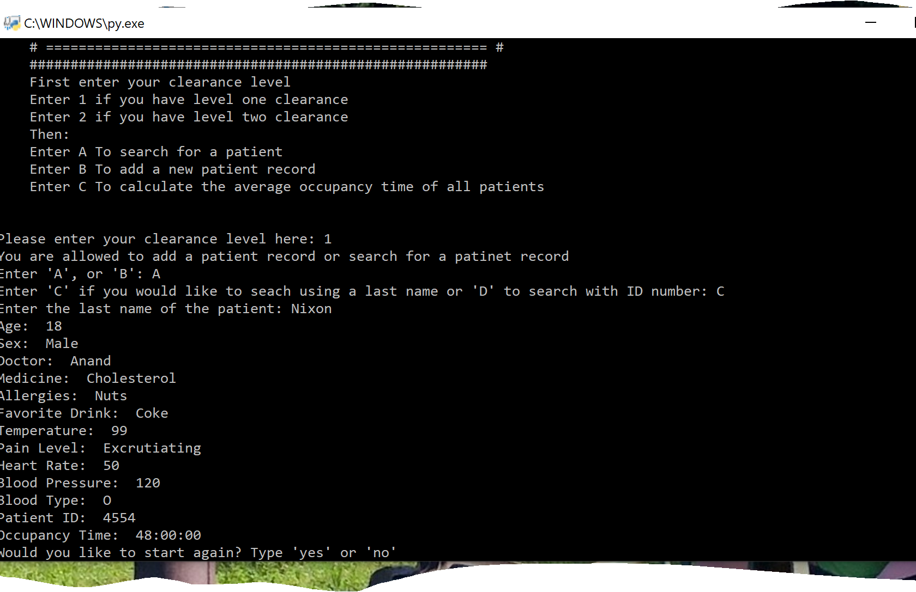
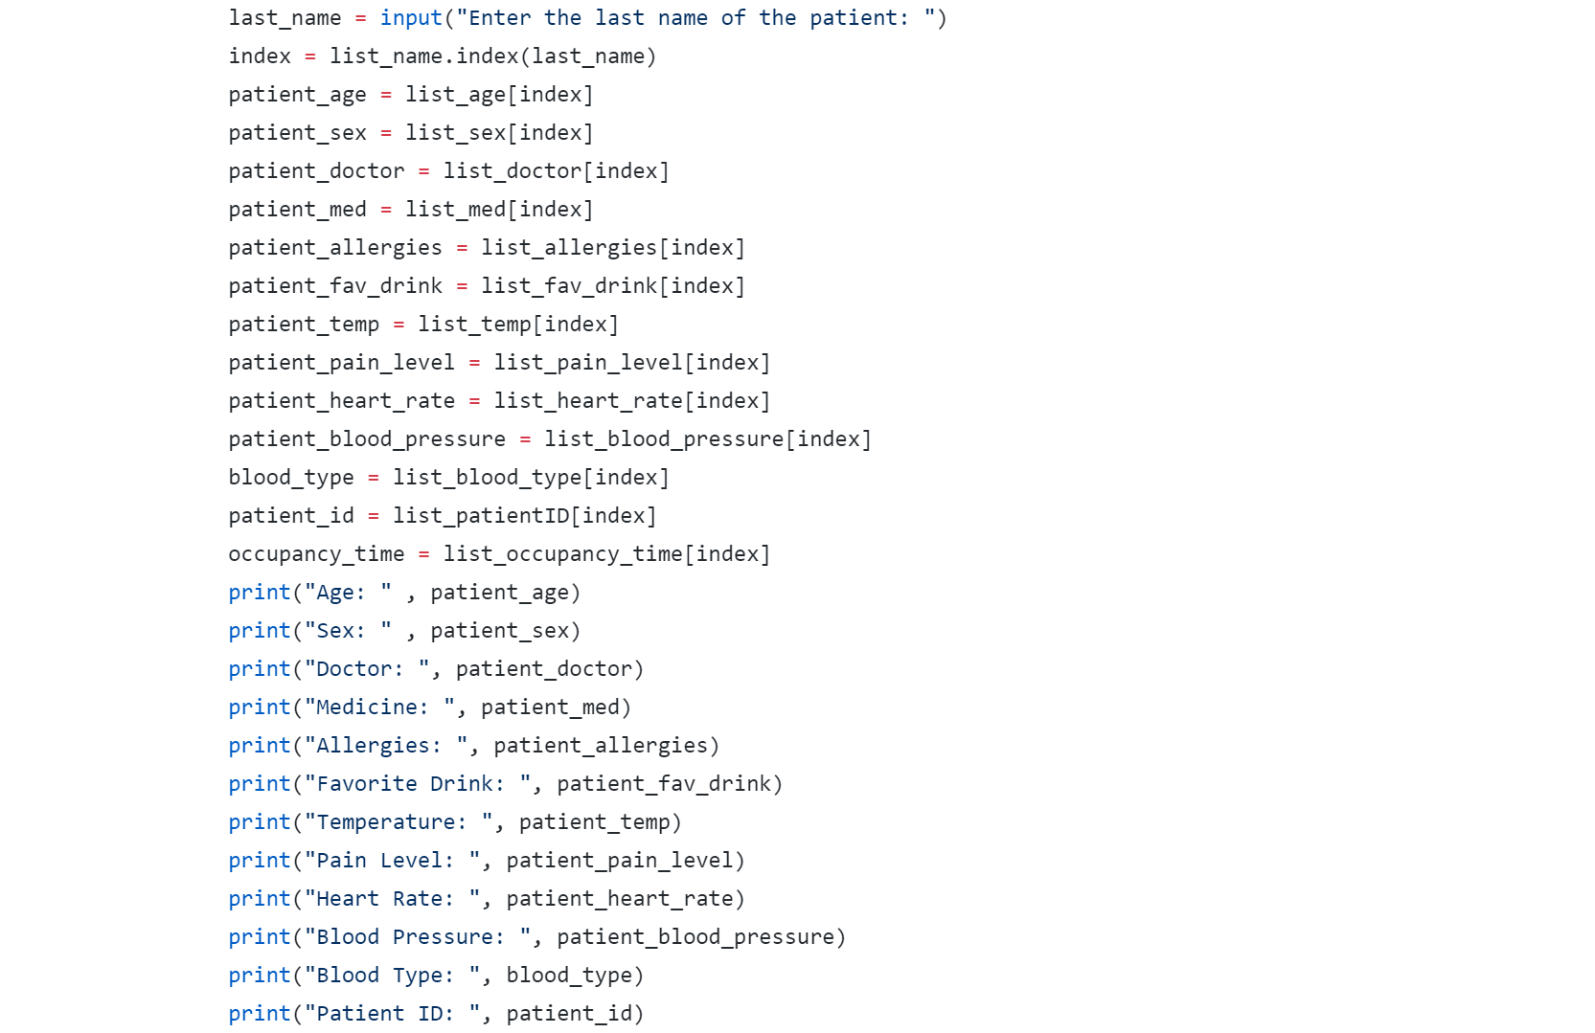
Coder: Alexis Nixon Project: Patient Questionnaire in E.R. Example Used: From Lulit Asfaw
Preference Questionnaire about patients for a more personable visit to E.R.
Asks questions to cater more to patients and their individual wants with out having to answer the same questions over and over

